Slide 1

OOP
Object Oriented Programming
Lecture 12
Lecture 1

Slide 2
Outline
Association, Aggregation, and Composition

Slide 3
Relationship Between Classes

Slide 4
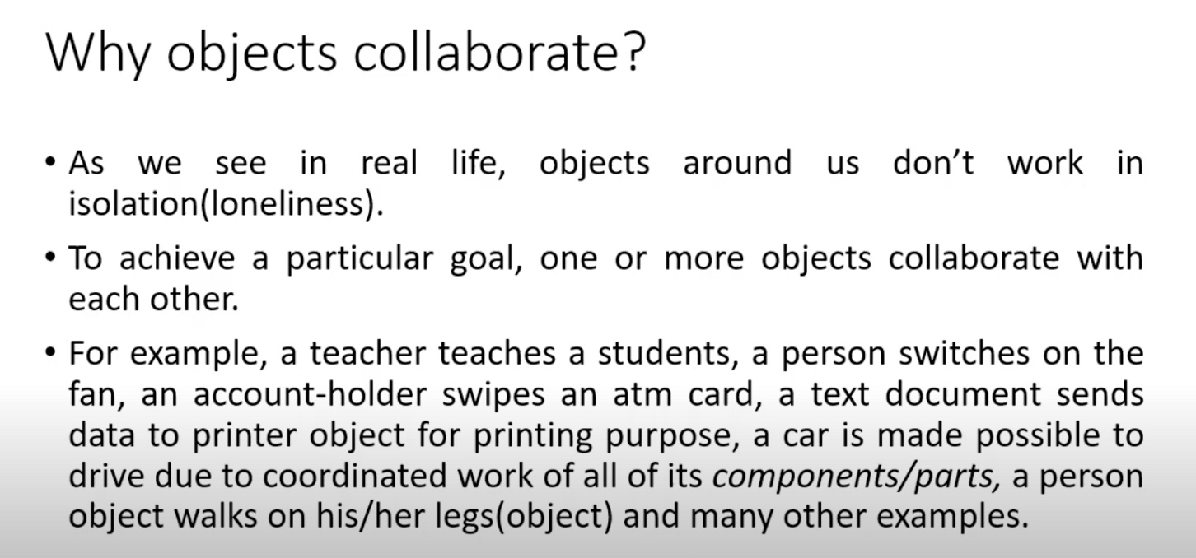

Slide 5
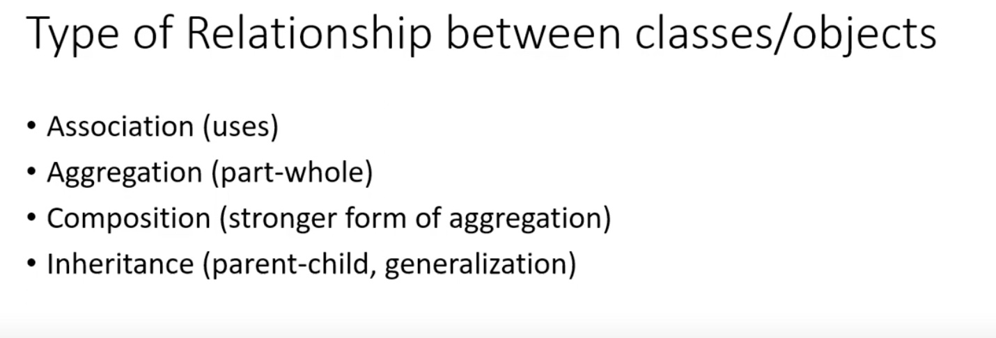

Slide 6
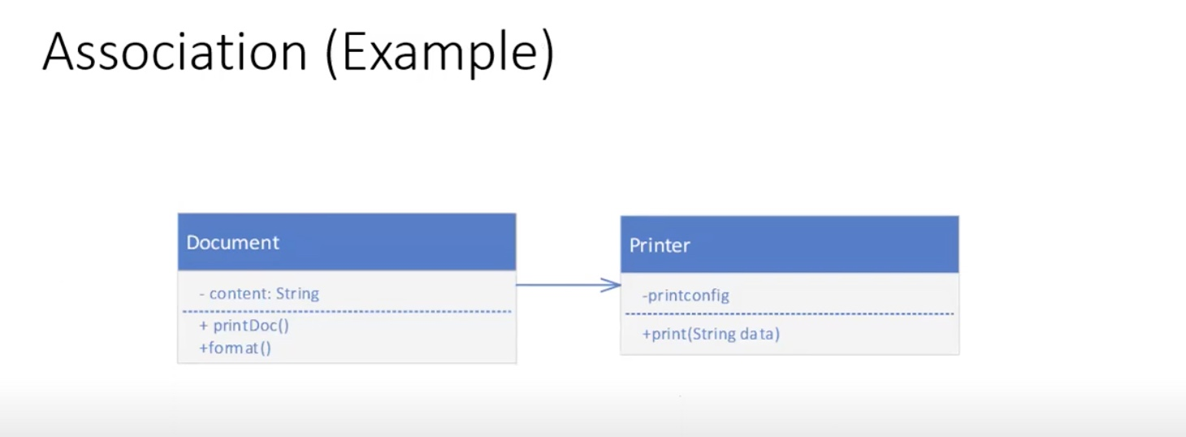

Slide 7
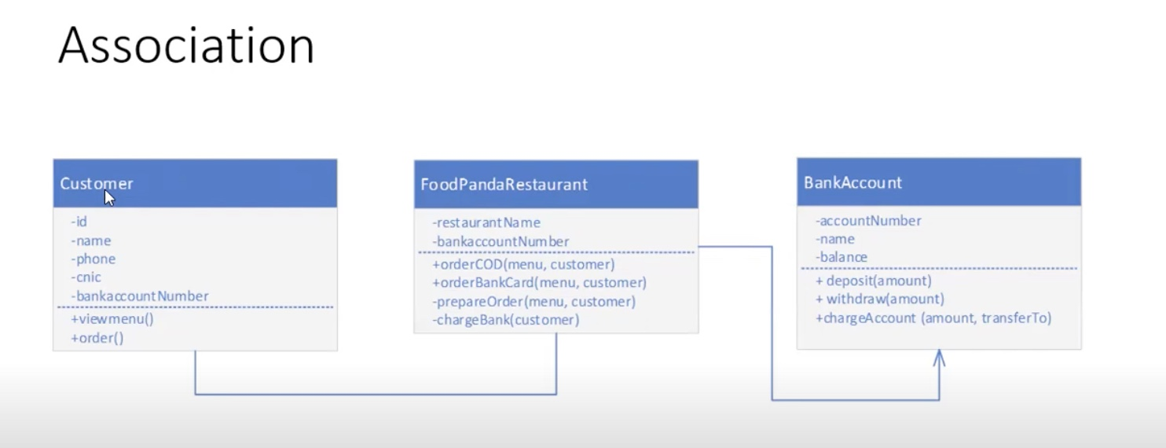

Slide 8
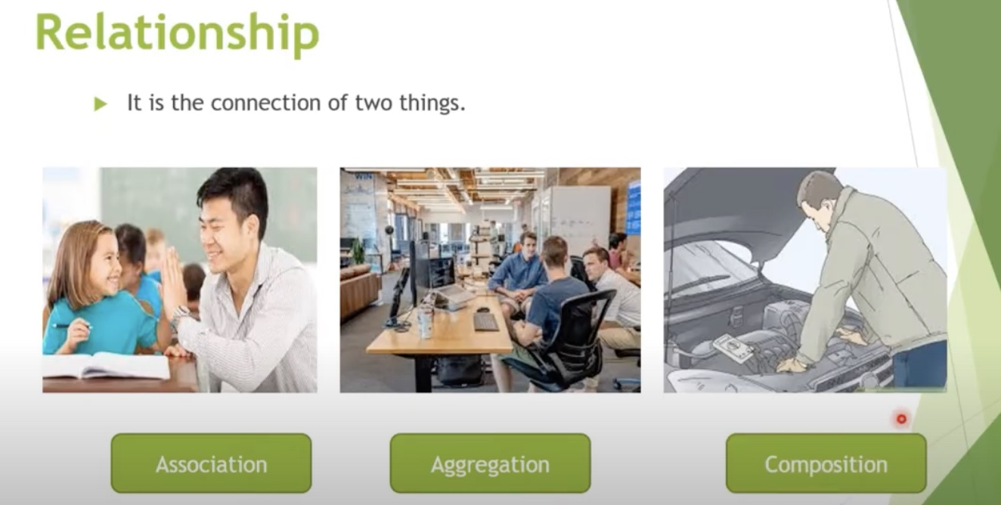

Slide 9
Aggregation
- Aggregation is a specialize form of association where all objects have their own lifecycles but there is an ownership like parent and child. Child object cannot belong to another parent object at same time. We can think of it as "has-a" relationship
Example: A single employee cannot belong to multiple companies, but if we delete the company, employ object will not destroy
Notes:
memory leak concept

Slide 10
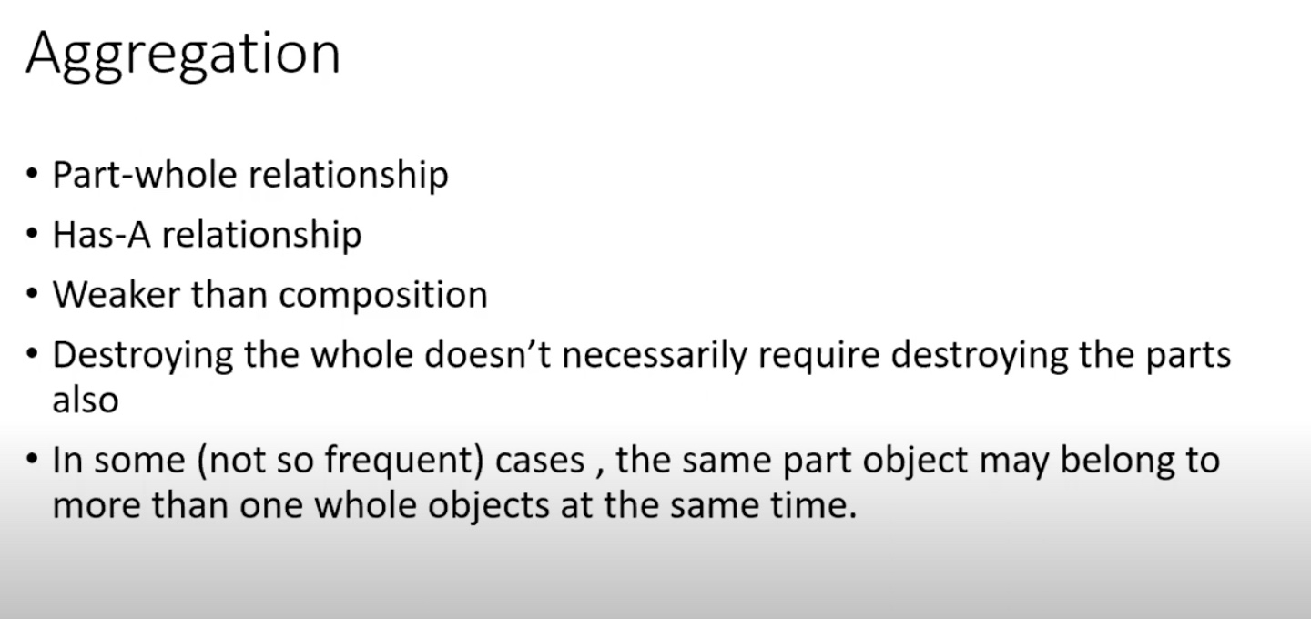
Aggregation
Notes:
memory leak concept

Slide 11
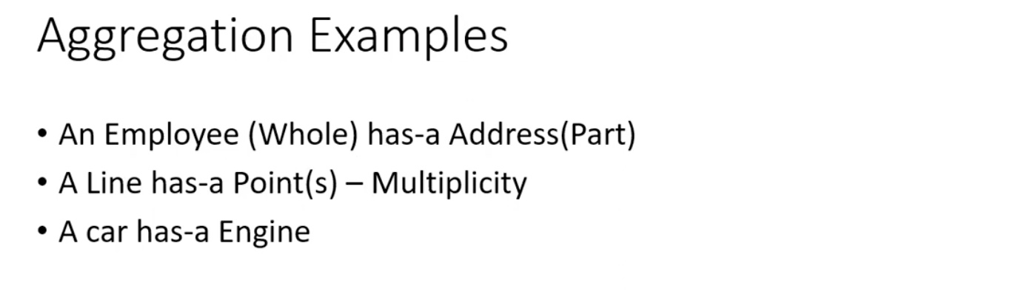
Aggregation
Notes:
memory leak concept

Slide 12
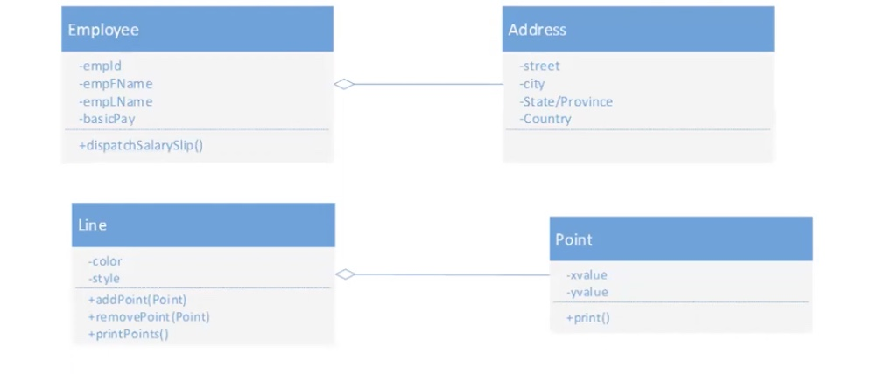
Aggregation

Slide 13
Coding Examples

Slide 14
End of Lecture

